Slide 1
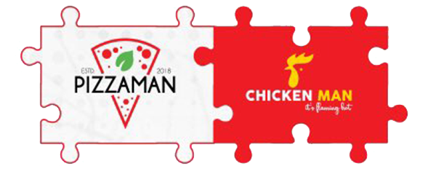
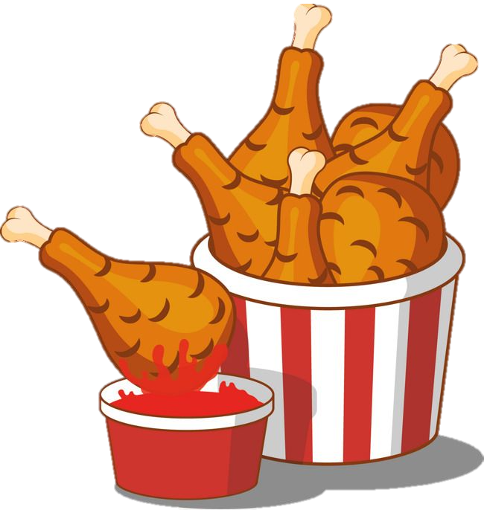
Marketing Pitch
Pizzaman-Chickenman

Slide 2
Overview of Our company
INTRODUCTION TO PIZZAMAN-CHICKENMAN
Mission Statement
"Our mission is to deliver an unparalleled dining experience by offering high-quality, scrumptious fast food, infused with authentic local flavours, to delight every customer (Ceqa Food & Beverages, n.d.)."
Pizzaman-Chickenman, established in January 2018, is a dynamic and beloved fast-food chain in Ghana (Pizzamanchickenman, n.d.).
Renowned for its delectable pizza, rice, and chicken dishes, the brand caters to a diverse clientele, carving a niche in Ghana's vibrant culinary landscape.
Unique Selling Proposition (USP)
Pizzaman-Chickenman stands out in the fast food market through its commitment to quality, use of locally sourced ingredients, and a menu that creatively blends international fast food appeal with distinct Ghanaian tastes (Pizzamanchickenman, n.d.).

Slide 3
MARKETING AUDIT AND SITUATION ANALYSIS
Market Overview:
Competition Analysis:
Ghana's fast-food industry is booming due to urbanization, evolving lifestyles, and rising disposable incomes (James, 2021).
Consumer preferences favour quick, convenient, and flavourful dining options (Omari, 2014).
Pizzaman-Chickenman competes in a dynamic market alongside key players like Papaye, KFC, and Chicken Inn.
Differentiation is seen through menu offerings, pricing strategies, and market reach.

Slide 4
SWOT Analysis
        Strong brand recognition
        A diverse menu appealing to local tastes
        A commitment to using locally sourced ingredients
        A strategic partnership with pinkberry (ice cream shop).
limited presence outside major urban areas
A high dependency on local market trends
Strengths
Weaknesses
Intense competition
Fluctuations in food prices
A potential shift in consumer preference towards healthier dining options
Expanding fast food market in Ghana
Potential for introducing new product lines
Exploring expansion into new geographical areas
Threats
Opportunities

Slide 5
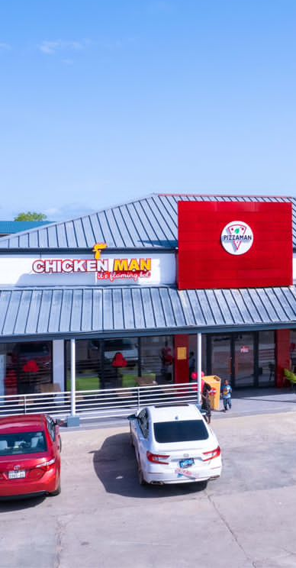
OBJECTIVES FOR PIZZAMAN-CHICKENMAN
Increase Sales and Customer Base
Enhanced Brand Visibility
Aim to increase overall sales by 15% and expand the customer base by 20% by Dec. 31, 2024
Implement targeted social media campaigns to enhance brand visibility and customer engagement, with measurable milestones set quarterly
Boost Online and In-Store Traffic
Achieve a 10% increase in online orders and 5% rise in foot traffic at all Pinkberry co-located outlets by end of 2024.
Leverage Pinkberry Partnership
Launch a joint marketing campaign with Pinkberry by September 2024 to capitalize on cross-promotional opportunities and enhance customer experience
New Menu Launch
Introduce two new locally inspired menu items by June 2024, targeting popular local flavours and trends

Slide 6

MARKETING STRATEGY AND TACTICS
Overall Marketing Strategy
Customer Engagement
Joint Promotions with Pinkberry
Leverage digital platforms for wider reach, enhance customer engagement, and maximize synergy with Pinkberry.
Implement customer feedback mechanisms, loyalty programs, and interactive social media contests to foster community and drive repeat business.
Developing joint marketing campaigns, including co-branded products, shared discounts, and unified loyalty rewards, to leverage the strengths of both brands.
Digital Marketing Initiatives
Product Strategy
We will launch targeted social media campaigns, collaborate with influencers, and use online advertising to increase brand visibility and attract a younger demographic
Introduce innovative menu items and special combos aligned with current trends, including unique cross-promotions with Pinkberry for a complete dining

Slide 7
IMPLEMENTATION AND ACTION PLAN
Activity | Timeline | Responsibility | Resource Allocation | Monitoring & Adjustment
Digital Marketing Campaigns | Q1-Q4, 2024 | Marketing Department | Budget for ads, social media tools | Monthly review of engagement metrics
New Menu Launch | Q2, 2024 (April-June) | Product Team | Budget for R&D, marketing | Sales tracking, customer feedback
Joint Campaigns with Pinkberry | Starting Q2, 2024 (April) | Joint Marketing Team (Pizzaman & Pinkberry) | Shared marketing budget, resources | Quarterly review of sales and feedback
Customer Engagement Programs | Q1-Q4, 2024 | Customer Service & Marketing Teams | Budget for loyalty programs, contests | Regular customer surveys, engagement analysis
Social Media Influencer Partnerships | Q3-Q4, 2024 | Digital Marketing Team | Influencer campaign budget | Tracking influencer campaign effectiveness

Slide 8
CONTROLS AND KEY PERFORMANCE INDICATORS
KPIs | Target | Data Collection Method | Review Frequency | Adjustment Strategy
Sales Growth | Increase by 15% annually | Sales data analysis | Monthly | Adjust marketing tactics based on trends
Website Traffic | Increase by 20% annually | Website analytics | Quarterly | Optimize digital marketing strategies
Social Media Engagement | Increase engagement by 25% | Social media analytics | Bi-monthly | Revise content strategy based on engagement data
Customer Acquisition Rate | Increase by 20% annually | Customer surveys, sales data | Quarterly | Enhance promotional offers and campaigns
Success of Joint Campaigns with Pinkberry | Achieve combined sales targets | Joint sales and marketing data | After each campaign | Joint review with Pinkberry to refine future campaigns

Slide 9
CONCLUSION AND NEXT STEPS
Summary of the Marketing Plan
Call to Action for Management
Our marketing plan focuses on boosting brand visibility, engage customers, and drive growth through digital campaigns, innovative products, and joint promotions with Pinkberry.
We seek your approval on the proposed budget and resource allocations. Your strategic guidance and decisions will be invaluable as we commence the implementation of this plan
Immediate Next Steps
Open for Feedback & Discussion
Immediately following this presentation, we propose to finalise the marketing calendar, initiate detailed discussions with Pinkberry for the joint campaigns, and launch the first phase of our digital marketing initiatives
We welcome your insights, feedback, and any suggestions you might have. Your perspective is crucial in refining and optimising our approach to ensure the success of this marketing plan

Slide 10
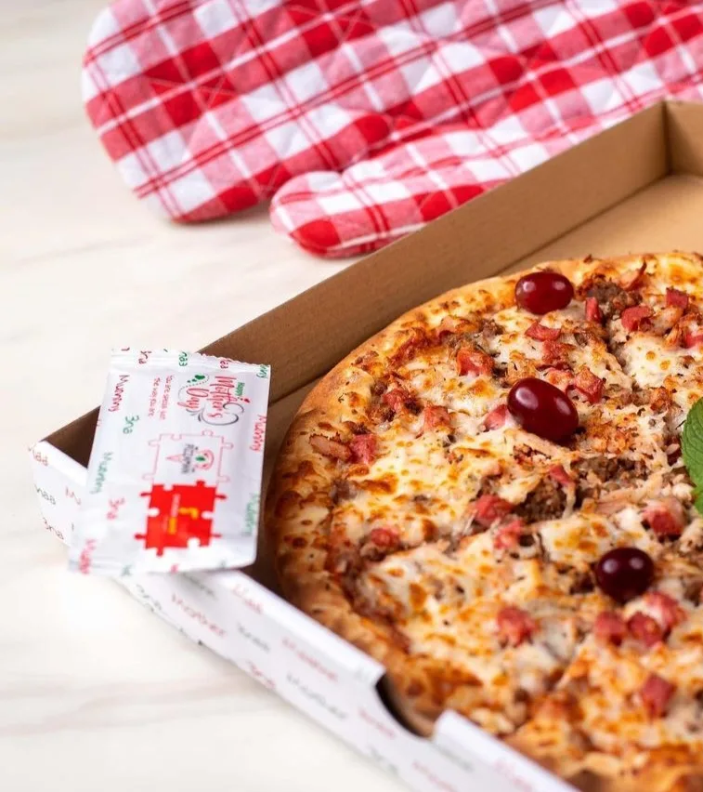
References
ceqa food & beverages. (n.d.). Ceqa Food & Beverages – is a fully owned Ghanaian company which aims at serving the people of Ghana and Africa with the best of meals. https://ceqaltd.com/about-us-1/
James, B. (2021, February). Ghanaians are eating more fast food: The who and the why. The Conversation. https://theconversation.com/ghanaians-are-eating-more-fast-food-the-who-and-the-why-153810
Omari, R. (2014,). Wageningen University & Research eDepot. https://edepot.wur.nl/318667
Pizzamanchickenman. (n.d.). Pizzaman Chickenman | Home. https://www.pizzamanchickenman.com
THANKS!

